Slide 1
Which Type of Pitcher is More Effective?
An analysis looking into whether starting pitchers or relief pitchers are more effective statistically.

Slide 2
Pitcher Definitions
Starting pitcher (starter)
First pitcher in a game for a team
At least 90% of games are starts
Relief pitcher (reliever)
Relieves a starter during a game, hence the name
May come in because:
Starter is tired, injured, ineffective, or ejected from a game
Starter only intended to pitch for certain number of innings for strategic reasons
At least 90% of games are not starts

Slide 3
Statistical Basis
Data loaded from the Pitching.csv file from the Baseball Dataset on Kaggle
Years 1920-2015, the “Live-ball” era
Statistics available for every year in this period
National League (NL) and American League AL
Which league has better ERA and WHIP over time?
Which league’s starters or relievers are better?
Starters with 100 innings pitched (IP) per stint (team/year combination)
Relievers with 50 IP per stint
This qualifies 5,463 starters and 5,283 relievers

Slide 4
Statistical Basis
Statistics used in this study to judge pitchers include:
Earned Run Average (ERA):
Rate of runs given up per nine innings that can be attributed to a pitcher
Excludes runs given up because of poor defensive play (i.e. errors)
Walks plus Hits per Innings Pitched (WHIP):
Assesses number of runners allowed to reach base via a hit or walk
Directly attributable to the pitcher
Excludes baserunners allowed because of poor defensive play (i.e. errors)
Strikeouts per 9 Innings (SO/9IP)
Assesses how much pitchers strike out batters without letting them on base
Exception uncaught third strike

Slide 5
Hypothesis
Starters are the more effective pitchers
They must face the best hitters in a lineup multiple times in a game
They must sustain their success over longer stretches of a game
They’re usually the best pitchers on a team because they have proven to better accomplish the above

Slide 6
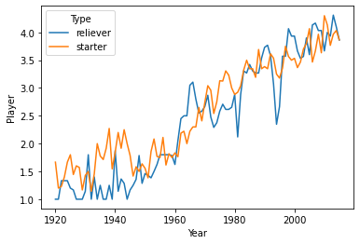
Number of Pitchers Per Type Per Team

Slide 7
Number of Pitchers Per Type Per Team
Less qualifying starters and relievers used per team in earlier decades
Most particularly less relievers in 1920s
Pitching rotations with fewer starters in earlier decades
Rotations gradually increasing in size over time
Bullpens also increasing, using more relievers over time
Relievers also being used in more specialized roles over time

Slide 8
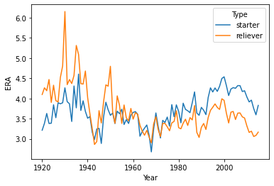
ERA Over Time

Slide 9
ERA Over Time
Starters have better ERA until about 1970
After 1970, relievers ERA better by ever increasing margin
Both most effective in late 1960s
Bob Gibson of St. Louis with historically low 1.12 ERA in 1968
Denny McLain of Detroit last to win at least 30 games in single season (1967)
Effectiveness decreased with hitter-friendly rule changes in 1969
Lowering of pitcher’s mound
Decrease of strike zone size

Slide 10
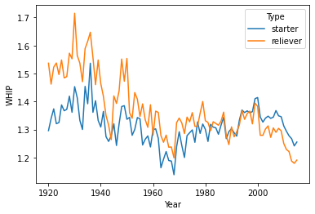
WHIP Over Time

Slide 11
WHIP over time
Starters better through 1980s
Exception 1940s around World War II era
Even throughout 1990s
Relievers increasingly better since 2000

Slide 12
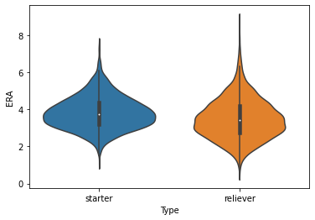
Distribution of ERA

Slide 13
Distribution of ERA
Relievers have lower ERAs overall
Median ERA 3.42 vs. starters’ 3.76 ERA
Both have slight skews toward lower end
Relievers’ skew more pronounced
Wider range for relievers
Possibly due to fewer innings to smooth out exceptionally good or bad games

Slide 14
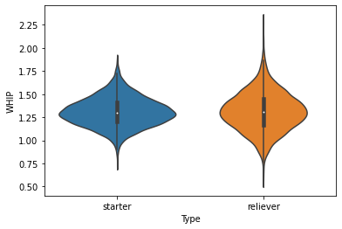
Distribution of WHIP

Slide 15
Distribution of WHIP
Virtually even for both pitcher types
Median WHIP for both about 1.3
Starters have even distribution with higher peak around median
Relievers slightly skewed toward lower end
Wider range for relievers
Possibly due to fewer innings to smooth out exceptionally good or bad stints

Slide 16
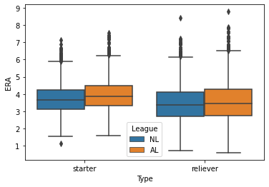
ERA by Type and League

Slide 17
ERA by Type and League
NL pitchers better ERA for both types
Low-end outlier Bob Gibson with 1.12 ERA
Both types and leagues with far more high-end outliers

Slide 18
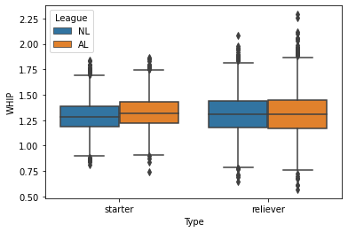
WHIP by Type and League

Slide 19
WHIP by Type and League
NL starters better than AL starters
Both leagues’ relievers about equally effective
Wider range for AL relievers
AL teams use a better-hitting designated hitter (DH) throughout entire game in lieu of a worse-hitting pitcher
NL teams tend to use pinch hitter in later innings when relief pitchers are used, must otherwise use pitcher to bat

Slide 20
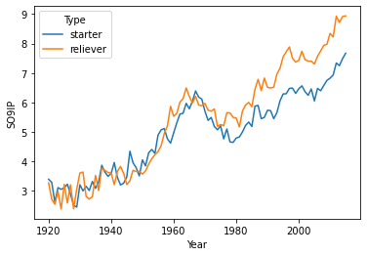
SO/9IP by Type

Slide 21
SO/9IP by Type
Relievers better most years since 1950s
Relievers increasingly better since about 1970
Starters better in 1920s

Slide 22
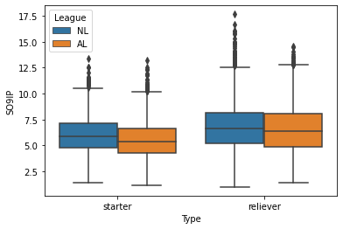
SO/9IP by League

Slide 23
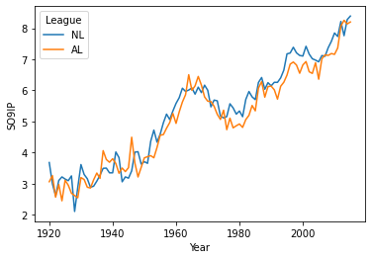
SO/9IP by League

Slide 24
SO/9IP by League
NL pitchers marginally better over time
NL pitchers striking more batters out than AL pitchers
Relievers overall better strikeout rate for both leagues
NL relievers with more high-end outliers

Slide 25
Conclusion
Relievers are more effective based on statistics looked at in this study
This may be due to several factors:
Out of necessity
Must pitch well to remain in major leagues
To avoid demotion to minor leagues
Desire for promotion to starting pitcher position
Have specialized positions and may excel in those positions
“Closer”: Finishes games when their team has small lead in order to preserve a win
“Setup”: Replaces a starter in later innings and must preserve a lead for the closer
When they face batter who has same dominant hand as the pitcher
For a certain amount of time in a game, usually shorter than a starter

Slide 26
Questions for Further Analysis
How do various factors and trends affect pitchers’ effectiveness over certain time periods?
Stadium dimensions and conditions
Rule changes
Pitch types and velocities
Individual years or decades
What other statistics, particularly sabermetrics, can be looked at to evaluate pitchers’ effectiveness?
How do defensive factors affect a pitcher’s effectiveness?
Errors, unearned runs, defensive runs saved, etc.

